Slide 1
DA4DTE: An Agentic System for Enhancing the Accessibility of Digital Twins of Earth
Myrto Tsokanaridou¹, Jakob Hackstein^{2,3}, Genc Hoxha^{2,3}, Sergios-Anestis Kefalidis¹, Konstantinos Plas^{1,6}, Begum Demir^{2,3}, Manolis Koubarakis^{1,6}, Marco Corsi⁴, Cristian Leoni⁴, Giorgio Pasquali⁴, Simone Tilia⁴, Chiara Pratola⁴, Nicolas Longepe⁵
¹Dept. of Informatics and Telecommunications, National and Kapodistrian University of Athens, Greece
²Technische Universitat Berlin, Germany
³BIFOLD - Berlin Institute for the Foundations of Learning and Data, Germany
⁴e-GEOS S.p.A., Italy
⁵Φ-lab, ESA ESRIN, Frascati, Italy
⁶Archimedes, Athena Research Center, Greece

Slide 2
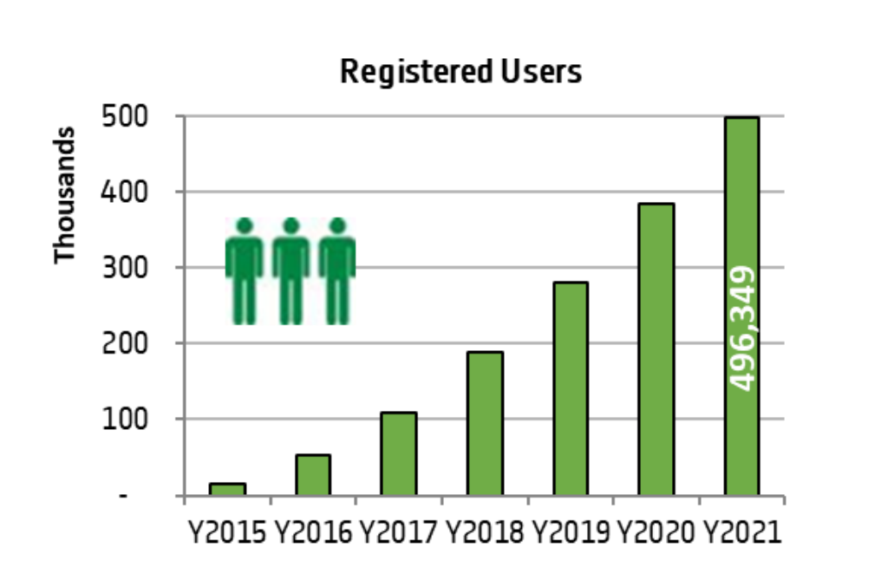
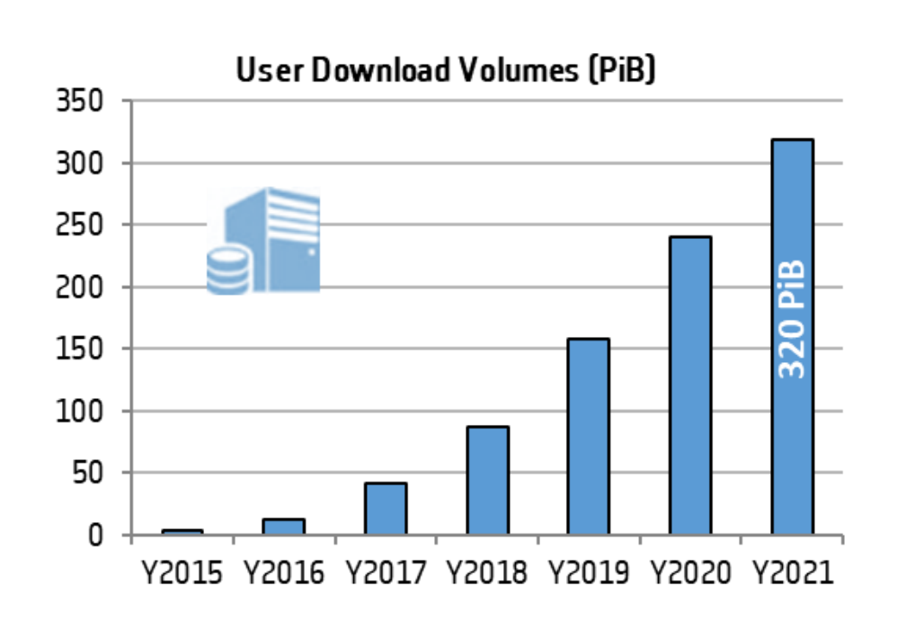
Why a Digital Assistant for Digital Twins of Earth?
Advances in satellite technology have led to regular, frequent, and high-resolution monitoring of Earth at global scale, providing an unprecedented amount of Earth observation data.
Through the Copernicus programme, Sentinel satellites reach the scale of more than 10 TB data per day.
Availability of a huge amount of satellite data has led to:
Increased demand for EO data from "laymen" such as journalists, business managers, university researchers, students and those that are simply curious.
The implementation of increasingly complex catalogues in order to manage an ever-expanding amount of data in an even shorter time.
Charts taken from Copernicus Sentinel Data Access Annual Report 2021

Slide 3
Why a Digital Assistant for Digital Twins of Earth?
We need a platform that simplifies search and retrieval from these massive archives and that also allows non-expert users to fully benefit from EO data.
The main objective of the project was to develop a first generation, AI-powered “Digital Assistant” interface to EO data by harnessing advances in and convergence of diverse digital technologies such as for example NLP, CV, KG (knowledge graphs) and content-based retrieval.
We introduce the Digital Assistant for Digital Twins of Earth (DA4DTE), an AI-powered multiagent system designed to facilitate seamless interaction with EO datasets:
Simplifies the use of EO catalogues, allowing queries in natural language in order to easily retrieve data
Facilitates the use of additional value that EO data sources could bring, simply by asking the platform to extract information from data
Charts taken from Copernicus Sentinel Data Access Annual Report 2021

Slide 4



Consortium presentation
INDUSTRIAL PARTNER
SCIENTIFIC PARTNERS
Scientific competences on the development of “Content-Based” Engines exploiting NLP, CV, KG, CBIR and other techniques to develop the Search Engines.
Scientific network and credibility to disseminate the results of the work in the broader community of NLP, CV, KG, CBIR scientists and practitioners, inside and outside the Earth Observation domain.
Industrial competences for the integration, deployment and demonstration of the precursor Digital Assistant.
Notes:
The project was developed by a consortium consisting of 3 members, a company and two universities. The national kapodistrian university of athens, led by Prof. Manolis Koubarakis and the Technical University of Berlin led by Prof. Begum Demir were responsible for developing the core functionalities and scientific engines of the digital assistant, while e-GEOS was tasked with providing the deployment and building the application for the DA.

Slide 5
Architecture
Notes:
Now, let’s take a look at the architecture of our system and how its agentic components interpret and tackle user requests.

Slide 6
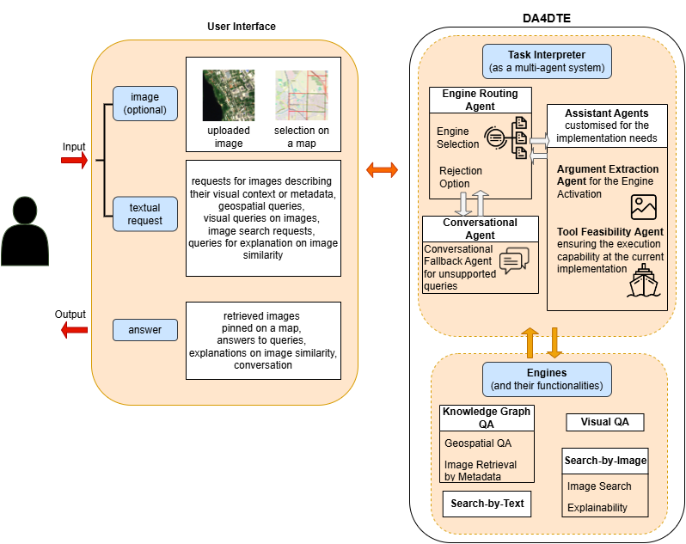
Agentic Orchestration
The Digital Assistant consists of:
❖ Front-end interfaces: Web UI, API
❖ Agentic Core: Responsible for task orchestration and conversing with the user.
❖ Content extraction engines: Specialized tools for retrieving and analyzing images.
❖ Auxiliary modules: Knowledge sources and the necessary infrastructure for deploying and running the system.
Notes:
First bullet points
The auxiliary modules are not been shown on the schema that you see on the right hand side. Our focus is on the agentic core and how it uses the content extraction engines to answer user requests.
NEXT SLIDE

Slide 7
Agentic Orchestration
The Agentic Core consists of Core agents and Assistant agents:
❖ Engine Routing Agent (Core): Zero-shot prompted LLM. Selects the engine to activate. Rejects requests that fall outside the scope of the available engines.
❖ Conversational Agent (Core): Designed to handle general, ambiguous, or out-of-domain queries. Prompted not to respond to irrelevant requests.
❖ Argument extraction Agent (Assistant): Extract key parameters required by specific tools
❖ Tool Feasibility Agent (Assistant): Responsible for validating whether a requested operation is feasible under current system capabilities
Notes:
Explain schema:
- We have our user who interact with our application through either the Web UI or the API.
Requests consist of text, and optionally an image.
This request is processed by our engine routing agent which serves as the entry point to the core of our system. This engine either propagates it to the conversational agent if it is out of domain/ambiguous or selects the appropriate tool for answering the request. In this case the two assistant agents also process the request to better understand it, extract useful arguments and ensure feasibility.
Then the request along with the arguments is send to the appropriate content extraction engine and the result is presented to the user.
NEXT SLIDE

Slide 8
Content-based Extractor Engines
Notes:
To better understand the capacity and capabilities of our digital assistant we owe to take a look at what tools are available to it. All of our tools have been built with responsiveness in mind, since we care about real-time user interaction with our system.

Slide 9
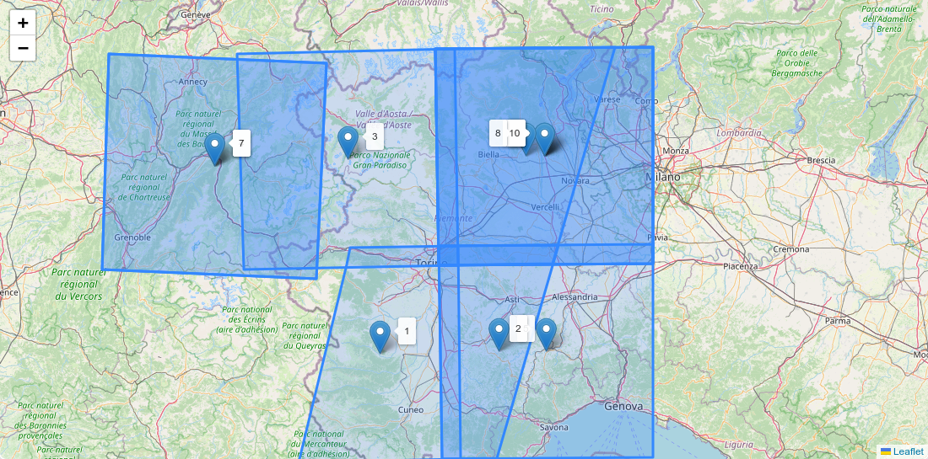
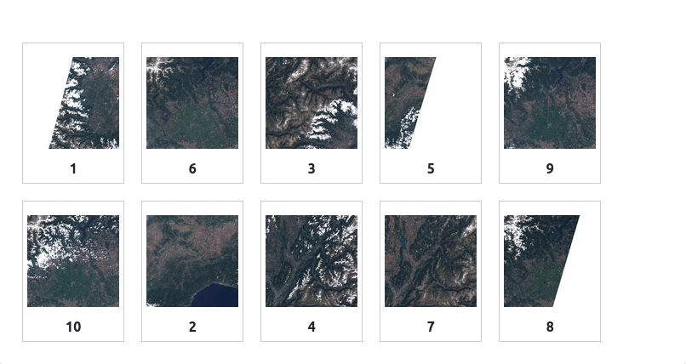
Knowledge Graph Question Answering Engine (TerraQ)
The Digital Assistant must be able to address requests for images that satisfy spatial, temporal and metadata-related constraints:
Find 10 images of Piedmont with cloud coverage under 20% and more than 50% vegetation, taken in August 2022.
Notes:
What is shown in the slide.
On the left hand side we see the outlines of these images placed on the map and they are indeed in the Piedmont region.
On the right hand side we see the images themselves, with low cloud coverage and high vegetation coverage.
Note that in this case we do not reason about image contents. We are only interested in metadata. So this is a purely NLP task.
NEXT SLIDE

Slide 10
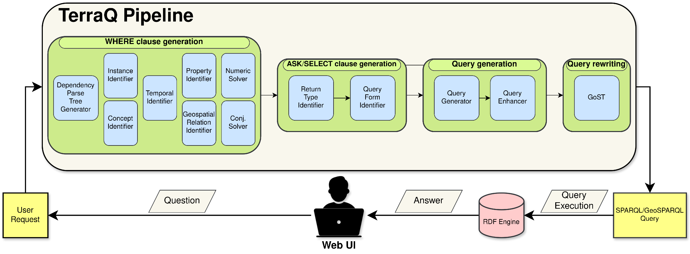
Knowledge Graph Question Answering Engine
TerraQ is a spatiotemporal question-answering engine for satellite image archives that targets a purpose-built knowledge graph which contains image metadata and geospatial information for administrative divisions and natural features.
TerraQ works by translating natural language requests into GeoSPARQL queries (Text-to-GeoSPARQL).
Implemented as a component pipeline that combines classical NLP techniques (fast) with LLMs (accurate).
Sergios-Anestis Kefalidis, Konstantinos Plas, Manolis Koubarakis: TerraQ: Spatiotemporal Question-Answering on Satellite Image Archives. IEEE International Geoscience and Remote Sensing Symposium (IGARSS 2025).
Notes:
Our knowledge graph integrates data from GADM, OSM, MarineRegions and of course Sentinel-1 and Sentinel-2 images. To facilitate fast and accurate responses we employ offline geospatial interlinking on our knowledge graph.

Slide 11
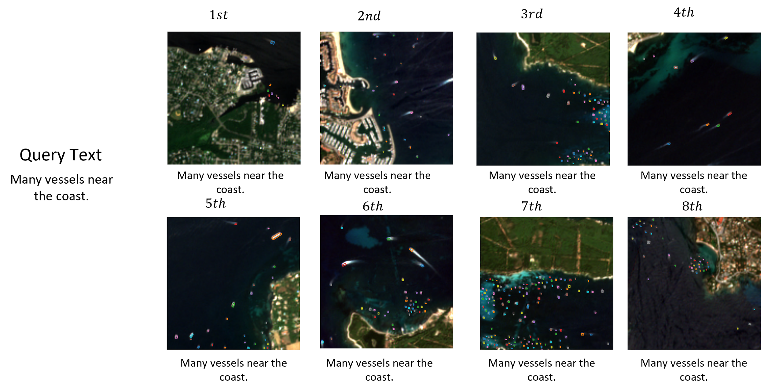
Search-by-Text Engine
The Digital Assistant must be able to retrieve images based on descriptions that cannot be answered by metadata :
Notes:
SLIDE
In cases where we are lacking the necessary metadata. Search-by-Text complements our KGQA engine. In this example, the amount of vessels in each image is not available in the image metadata.

Slide 12
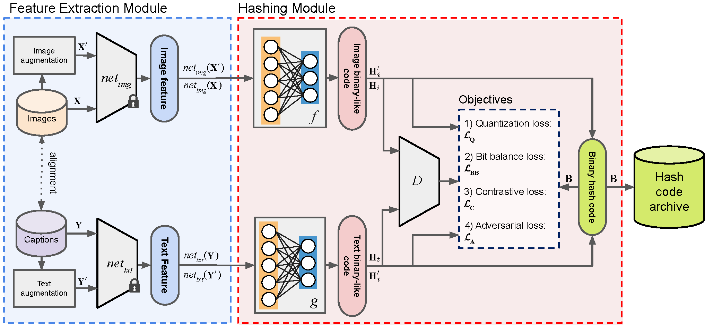
Search-by-Text Engine
We employ the DUCH (deep unsupervised cross-modal contrastive hashing) method, which provides cross-modal retrieval between remote sensing images and text sentences:
The feature extraction module produces deep semantic representations for image and text modalities
The hashing module that generates binary representations from the input extracted deep features
The hamming distance between images in the archive and the generated binary representation is used to evaluate similarity
G. Mikriukov, M. Ravanbakhsh, B. Demir, “Unsupervised Contrastive Hashing for Cross-Modal Retrieval in Remote Sensing,” IEEE International Conference on Acoustics, Speech, & Signal Processing (ICASSP).
Notes:
The hash code archive contains hashcodes for all images in our system and is created offline. The use of hash codes for image retrieval ensures rapid response time.

Slide 13
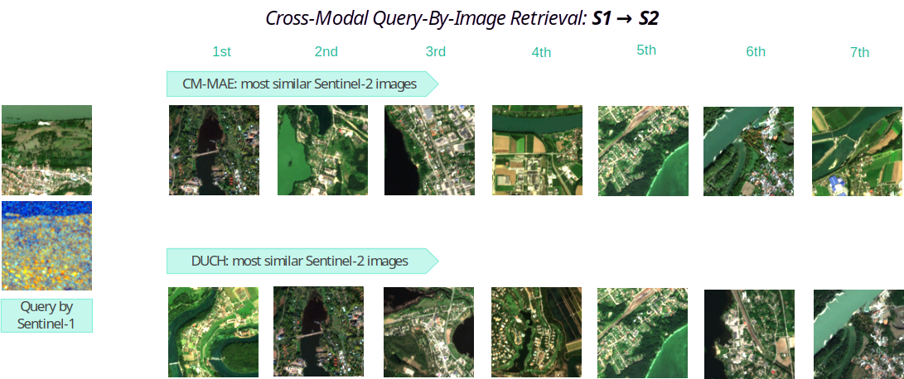
Search-by-Image Engine
The Digital Assistant must be able to retrieve images similar to a selected image (uni-modal and cross-modal):

Slide 14
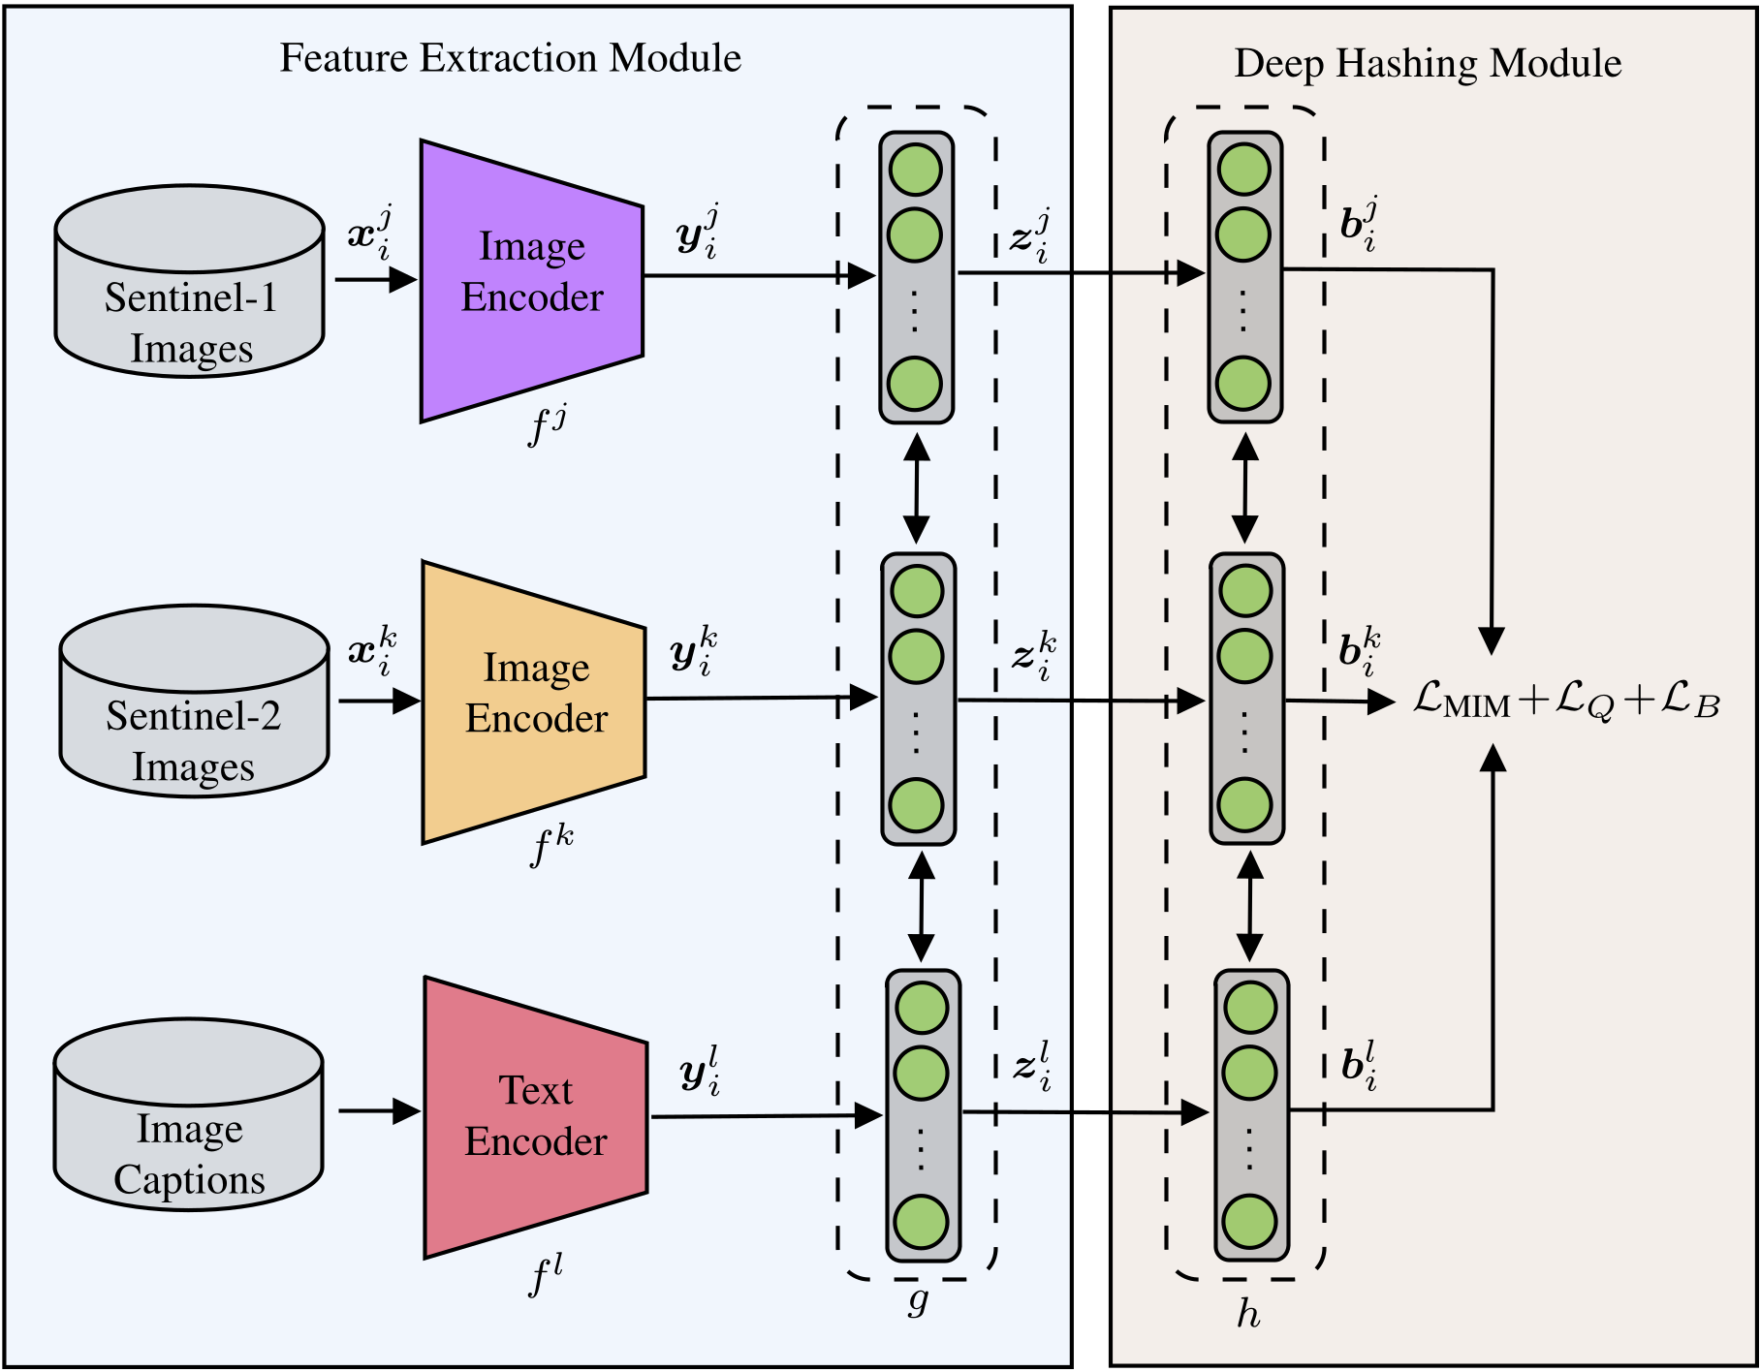
Search-by-Image Engine
We adapted the deep unsupervised cross-modal contrastive hashing (DUCH) method.
Notes:
We extended DUCH to work for S1-S2 cross modal.
NEXT SLIDE

Slide 15
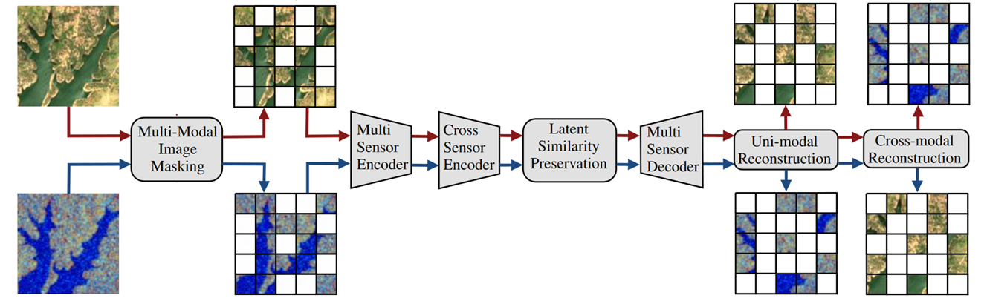
Search-by-Image Engine
We also developed the cross modal masked autoencoder (CMMAE) method.
Jakob Hackstein, Gencer Sumbul, Kai Norman Clasen, Begüm Demir: Exploring Masked Autoencoders for Sensor-Agnostic Image Retrieval in Remote Sensing. IEEE Trans. Geosci. Remote. Sens. 63: 1-14 (2025)
Notes:
NEXT SLIDE

Slide 16
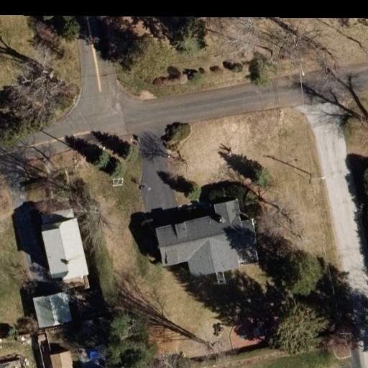
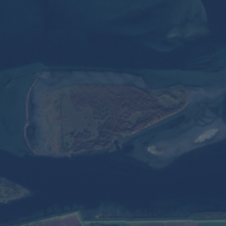
Visual Question Answering Engine
The Digital Assistant must be able to analyze images and answer questions about their contents.
Question: Is there an agricultural area in this scene?
Answer: No
Question: Is this a rural area?
Answer: Yes
Notes:
Last but not least, SLIDE

Slide 17
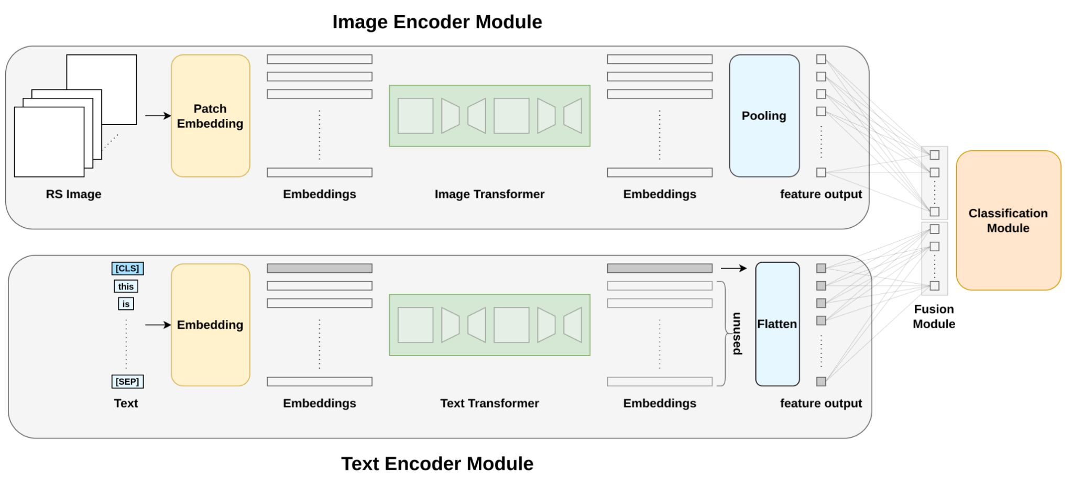
Visual Question Answering Engine
The LiT-4-RSVQA architecture provides accurate VQA results while significantly reducing the computational requirements:
We use transformers to get representations (i.e., embeddings) for the question and image.
We project the embeddings in a common space.
We use the fused embeddings as input in a neural classification module.
Leonard W. Hackel, Kai Norman Clasen, Mahdyar Ravanbakhsh, Begüm Demir: LIT-4-RSVQA: Lightweight Transformer-Based Visual Question Answering in Remote Sensing. IGARSS 2023.

Slide 18
User Interface
Notes:
To finish the presentation let’s see a quick snapshot of our system in action.

Slide 19
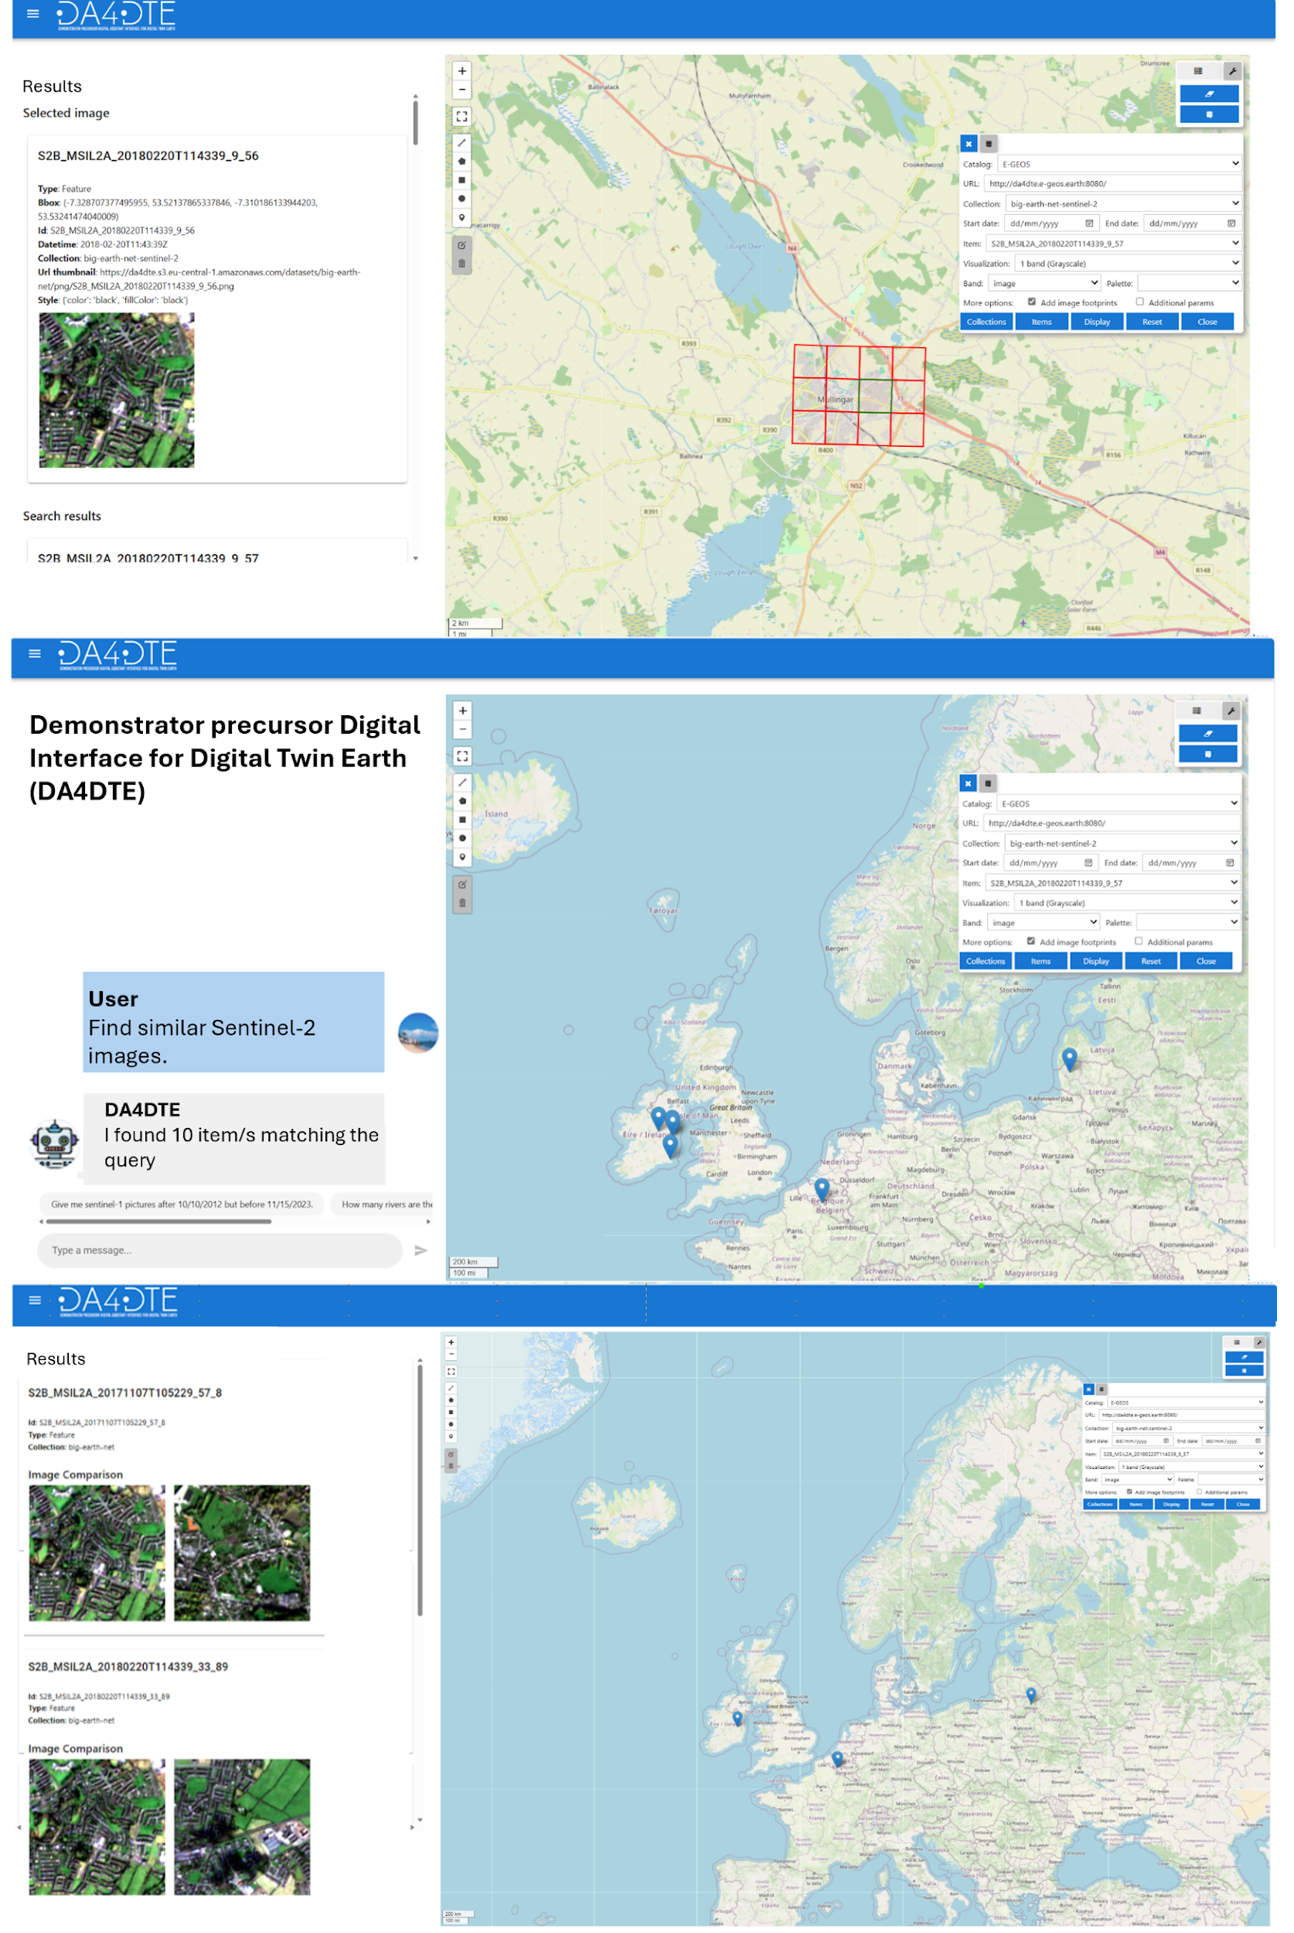
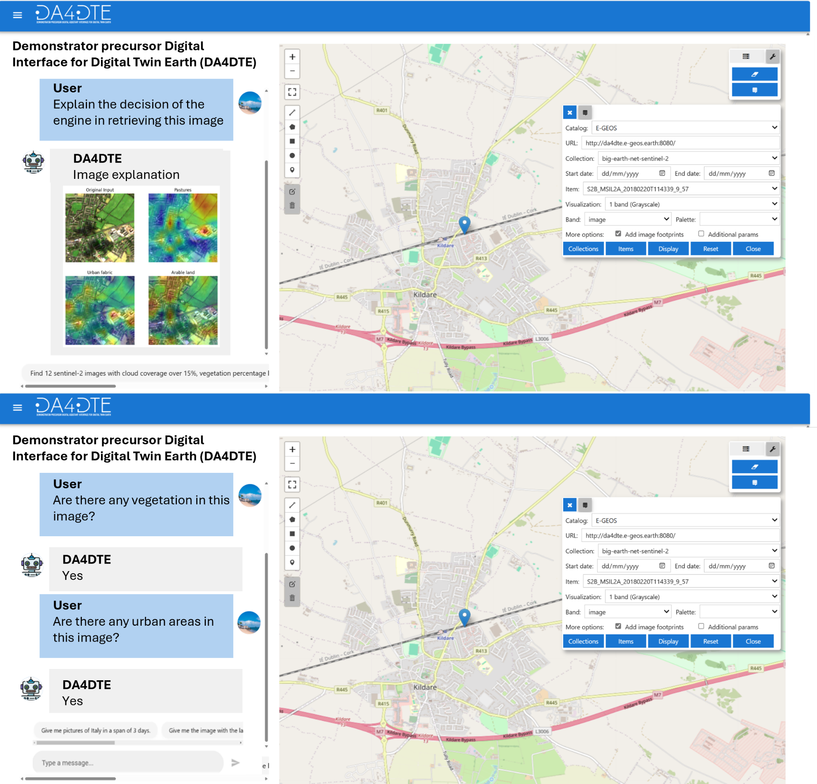
Notes:
This is a collection of 5 screenshots showcasing a workflow in our system.
The user has first selected an image.
Then they request similar sentinel-2 images.
The images are retrieved and shown side by side with the original images.
The user then requests explanation of why these images were deemed similar, and a heatmap with LULC classes is generated to show the perceived similarity visually.
Finally the user engages with the VQA engine to ask for information about the selected image.

Slide 20
Thank you for your attention!

